Slide 1

Introduction to Laravel
By Jerone Alimpia

Slide 2
What am I Covering?
What is Laravel?
Install Laravel with Composer
Routing
Controllers
Views
Blade Templates
Database and Eloquent ORM
Form (Requests & Input)
Basic CRUD with validation

Slide 3
Tools we Need
Composer
IDE (VS Code)
XAMPP (Database)
Node.js
Browser

Slide 4

What is Laravel?
Laravel is a MVC web application framework with expressive, elegant syntax created by Taylor Otwell in 2011.
Free open-source license with many contributors worldwide.
Has powerful features, saving us time.
Laravel is the best choice for building modern, full-stack web applications
Laravel is incredibly scalable
One among Top 10 Web Frameworks for 2021

Slide 5
What is MVC?
The Model-View-Controller (MVC) is an architectural pattern that separates an application into three main logical components: the model, the view, and the controller.
MVC is one of the most frequently used industry-standard web development framework to create scalable and extensible projects.
The Model component corresponds to all the data-related logic that the user works with.
The View component is used for all the UI logic of the application.
The Controllers act as an interface between Model and View components to process all the logic.

Slide 6
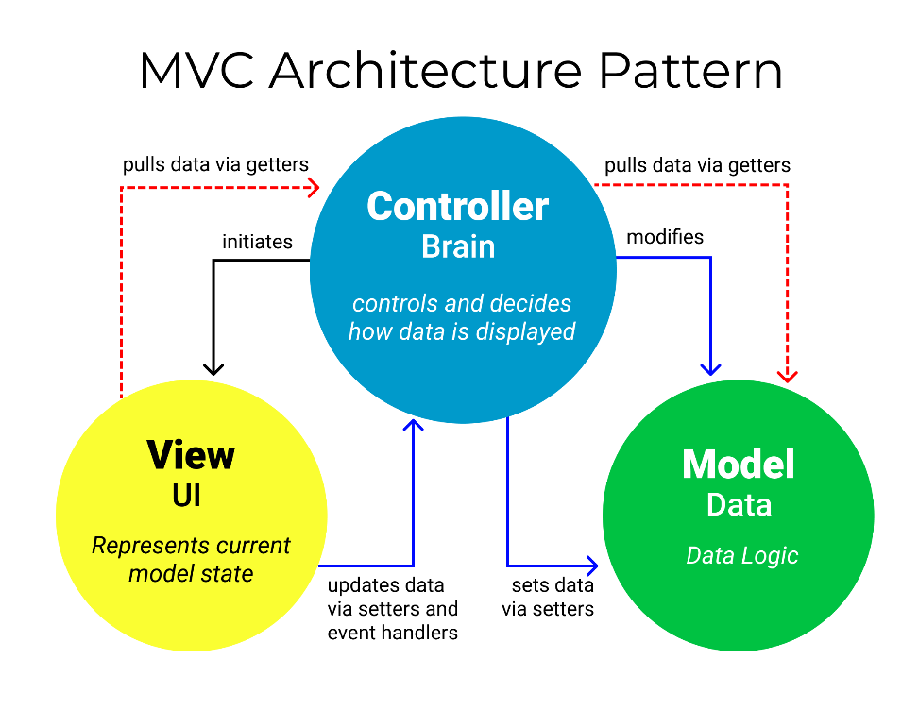
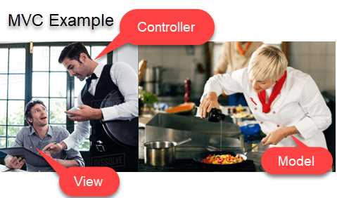

Slide 7
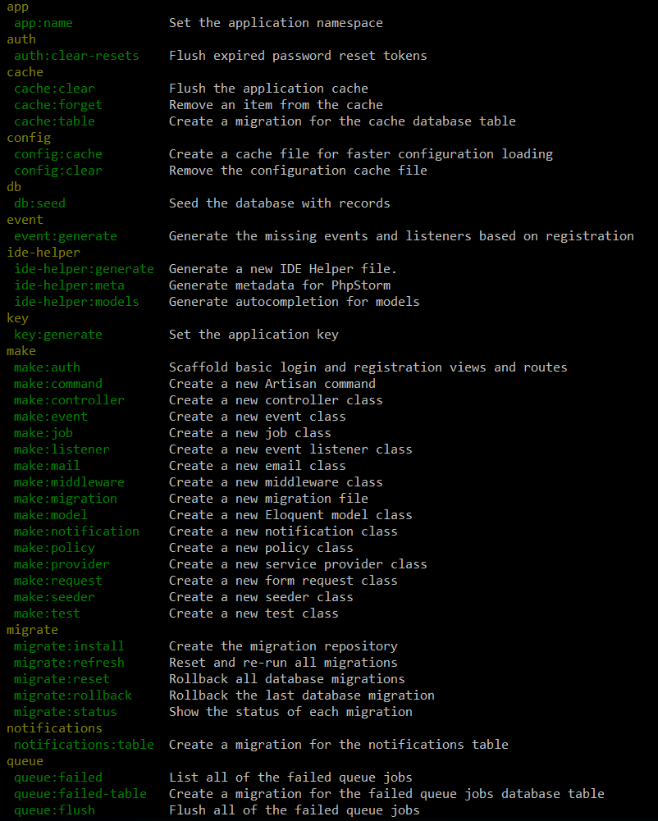
Artisan Console
Artisan is command-line interface for Laravel
Commands that are saving time
Generating files with artisan is recommended
Run php artisan list in the console
Every command also includes a "help“
>php artisan help migrate

Slide 8
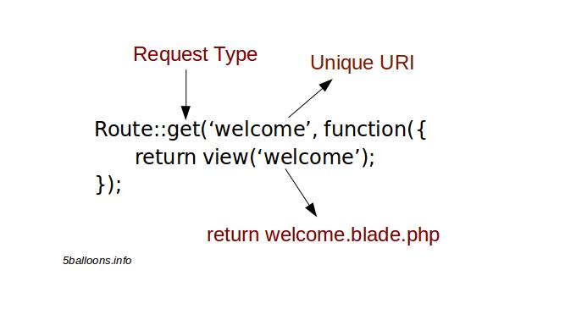
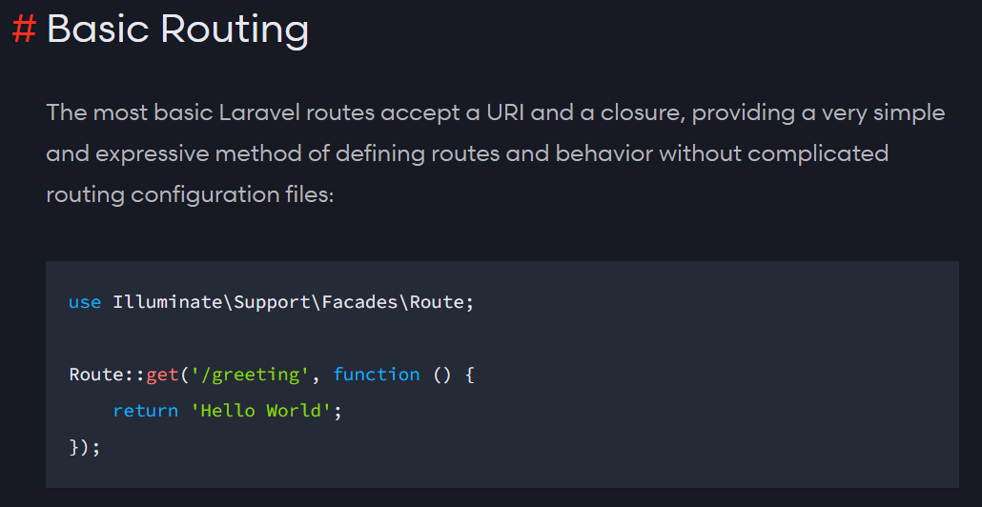
Routing
The best and easy routing system I’ve seen
Routing per request method (GET, POST, DELETE, etc.)
ALWAYS name your route !
Be careful with the routing order !
Let’s see routing examples

Slide 9
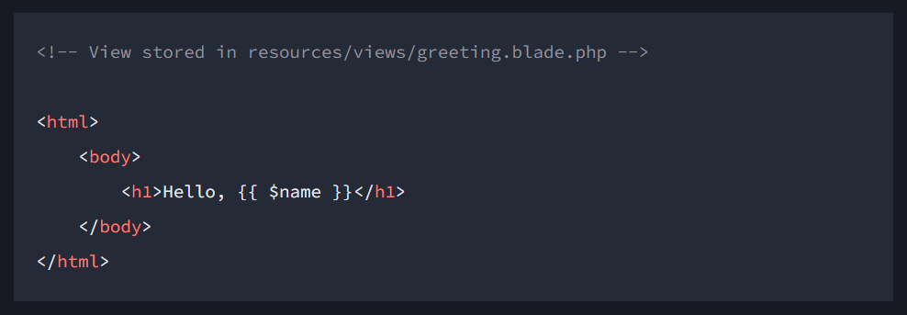
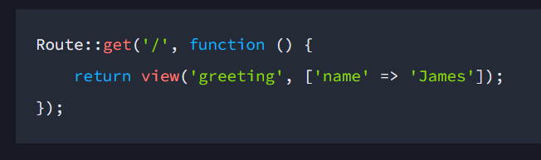
Views
Views provide a convenient way to place all of our HTML in separate files.
Once you have created a view, you may return it from one of your application's routes.

Slide 10
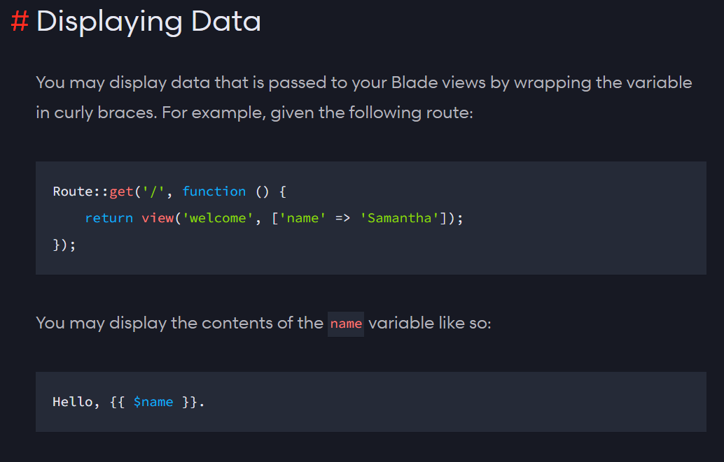
Blade Template
Blade is the powerful template engine provided by Laravel
All the code inside blade file is compiled to static html file
Supports plain PHP
Saves time
Better components mobility, extend and include partials
Let’s take a look at few examples

Slide 11
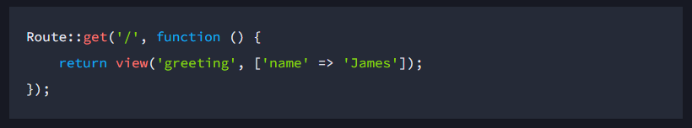
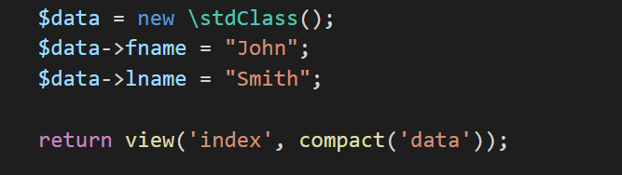
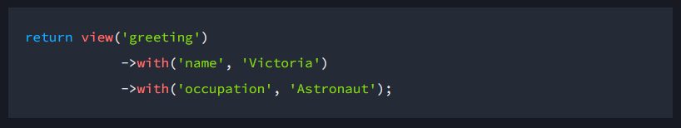
Passing Data to View
You may pass a variable or array of data to views to make that data available to the view.
You may use the with method to add individual pieces of data to the view.

Slide 12
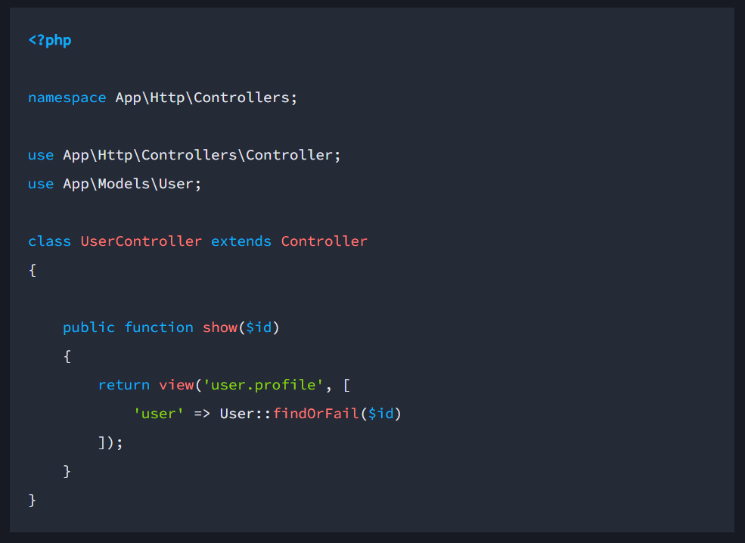
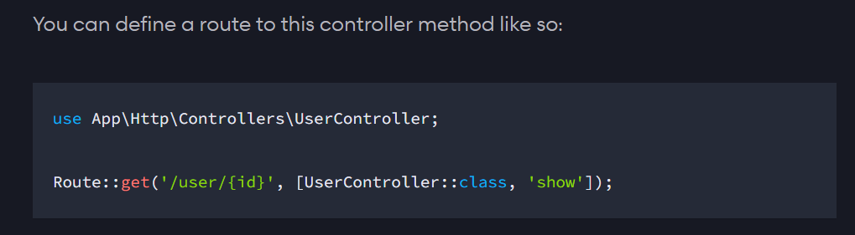
Controllers
Controllers can group related request handling logic into a single class.
It acts as a directing traffic between Views and Models.
>php artisan make:controller <controller-name>
The created controller can be called from routes.php by the following syntax.
Route::get(‘base URI’,’Controller@Method’);
Or
Route::get(' base URI ', [Controller::class, Method']);
Don’t forget to un-comment "$namespace" variable in (app\Providers\RouteServiceProvider.php)

Slide 13
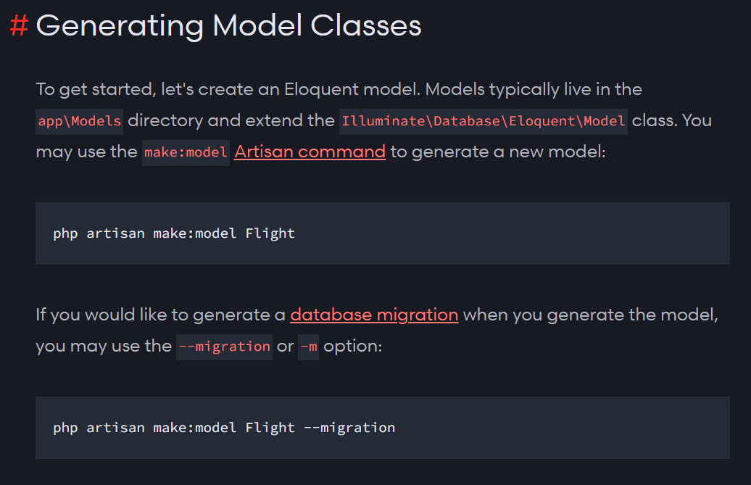
Models
Laravel includes Eloquent, an object-relational mapper (ORM) that makes it enjoyable to interact with your database.
When using Eloquent, each database table has a corresponding "Model" that is used to interact with that table.
Eloquent models allow you to insert, update, and delete records from the table as well.
Be sure to configure a database connection in your application’s .env file.
> php artisan make:model Flight --migration

Slide 14
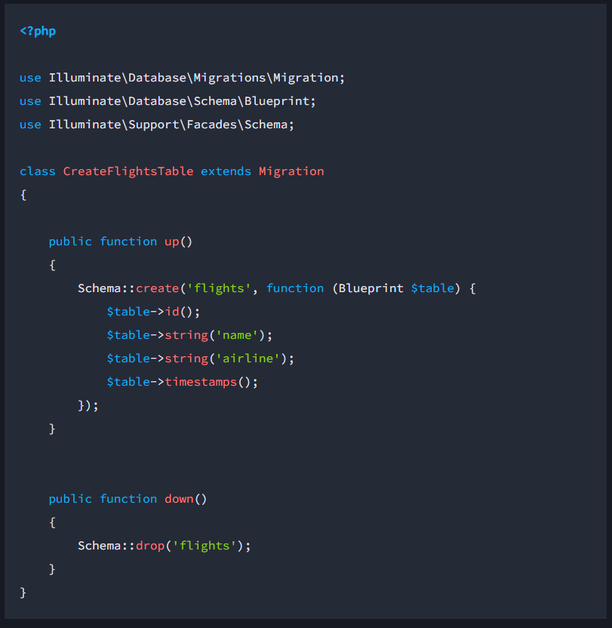
Migration Files
Migrations are like version control for your database.
Allowing your team to define and share the application's database schema definition.
It provides database agnostic support for creating and manipulating tables across all of Laravel's supported database systems.
>php artisan make:migration create_flights_table
>php artisan migrate --path=/database/migrations/fileName.php

Slide 15
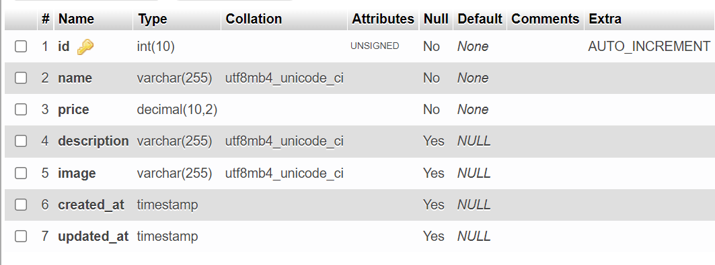
Sample Schema for Products Table
$table->increments('id');
$table->string('name');
$table->decimal('price', 10, 2);
$table->string('description')->nullable();
$table->string('image')->nullable();
$table->timestamps();

Slide 16
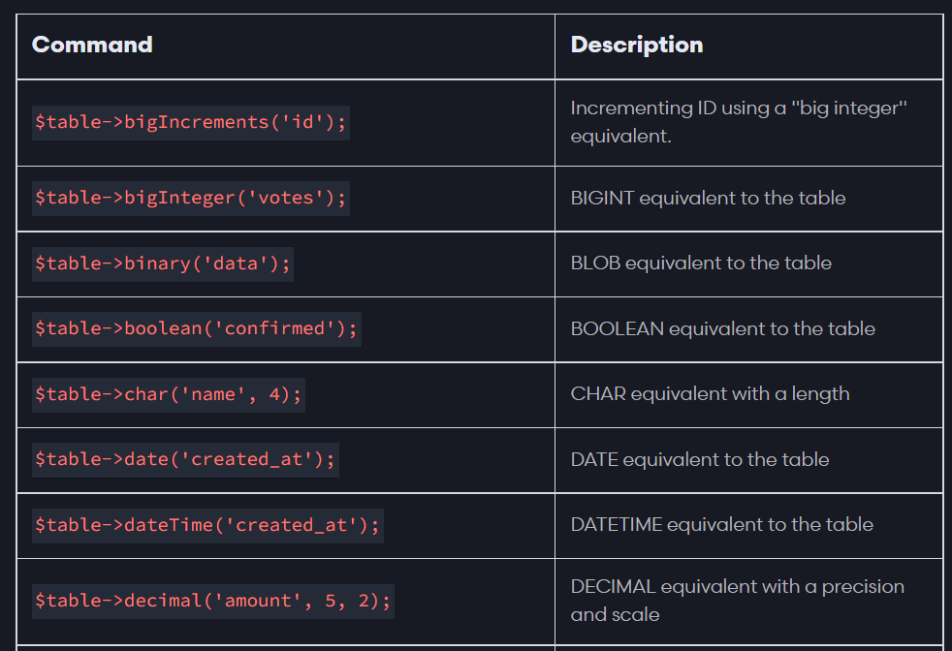
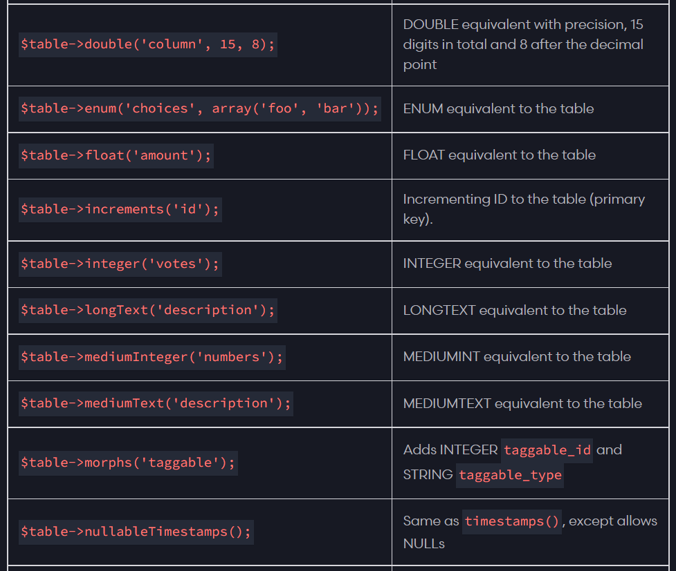
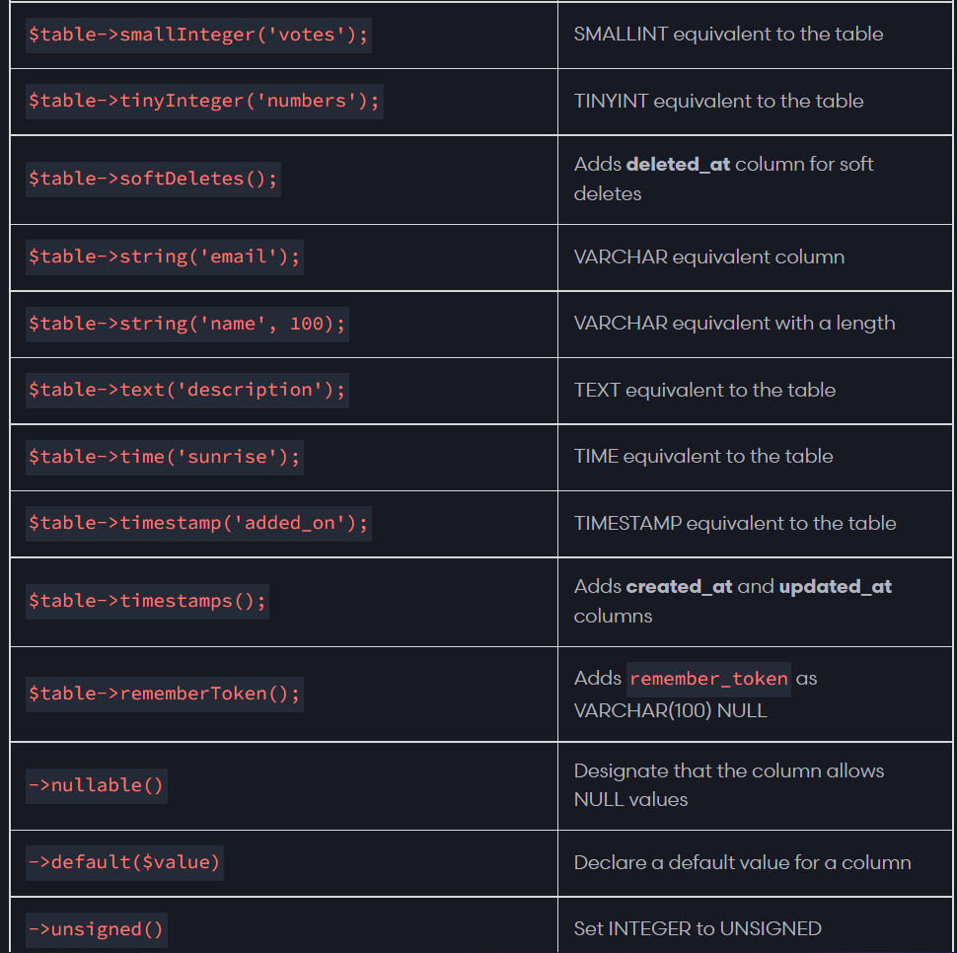
Migration Files
The table builder contains a variety of column types that you may use when building your tables:

Slide 17
Form Request & Input
//For Submitting form using POST request method {{ csrf_field() }}
//For Updating form using POST request method
{{ method_field('PATCH') }}
//To redirect to previous page with session
return redirect()->back()->with(‘success’, ‘Success!’);
//To check of session variable has value
@if(session()->has('message'))
<div class="alert alert-success">
{{ session()->get('message') }}
</div>
@endif
//Get URL Variables value $request->input('id');

Slide 18
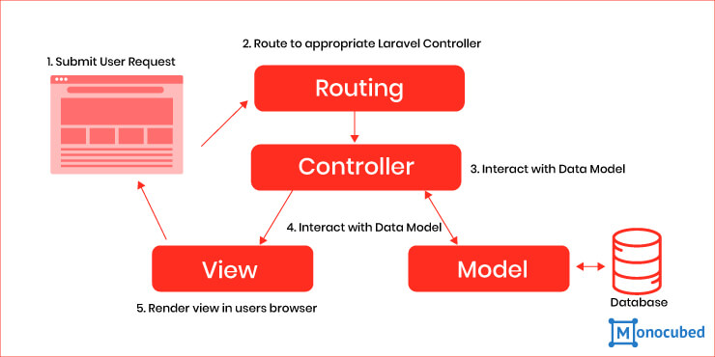

Slide 19

Let’s install Laravel
Laravel uses Composer to manage its dependencies.
Composer is dependency management tool for PHP, like a library full of books.
Per project tool (vendor folder), not per system
Install by using the command:
>composer global require laravel/installer >laravel new <app_name> >composer require laravel/ui >php artisan ui bootstrap >npm install && npm run dev

Slide 20
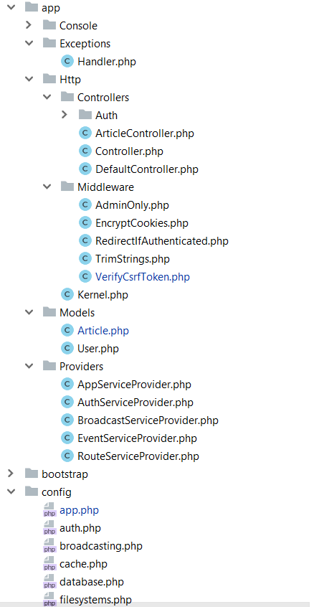
Laravel Structure
app/Http folder contains the Controllers, Middlewares and Kernel file
All the models should be located in app/Models folder
The service providers that are bootstrapping functions in our app are located in app/Providers folder
All the config files are located in app/config folder

Slide 21
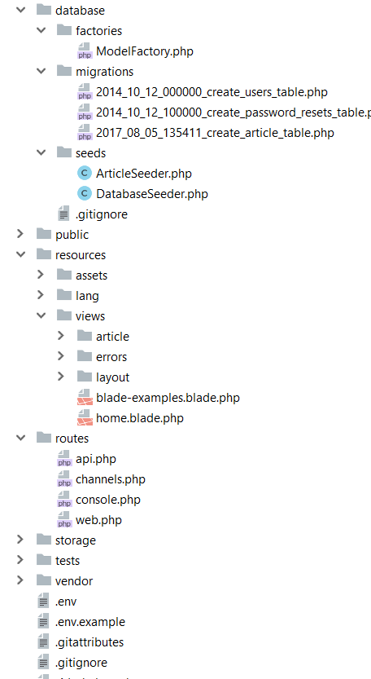
Database folder contains the migrations and seeds
The public folder is the actual folder you are opening on the web server.
All JS / CSS / Images / Uploads are located there.
The resources folder contains all the translations, views and assets (SASS, LESS, JS)
that are compiled into public folder
The routes folder contains all the routes for the project
All the logs / cache files are located in storage folder
The vendor folder contains all the composer packages (dependencies)

Slide 22
Thank You!

